Slide 1


HTML
Introduction to HTML5

Slide 2


Agenda
1
Introduction to HTML5
2
Creating Form Input and Validation

Slide 3

Introduction to HTML5

Slide 4
Objectives
At the end of this module, you will be able to :
Understand HTML 5
Different browser support for HTML 5
Different HTML 5 elements

Slide 5
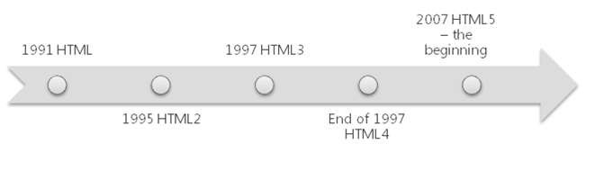
What Is HTML 5
The new version of HTML
A new and emerging set of web standards and specifications
HTML5 is HTML + CSS3 + JavaScript APIs

Slide 6
What Is HTML 5
HTML5 allows for the creation of better web applications and websites.
UsingHTML5, web developers can expose graphics and multimedia to webpa
ges with no need for plugins, use advanced JavaScript APIs such as
client-side storages, arrange their webpages with a more meaningful structure, and embed semantics in their content.
In 1991, the first HTML specifications were published.
The second release of HTML (HTML2) was published in 1995, introducing f orm-based file uploads, tables, and more.
In early 1997, a new and improved HTML specification (HTML3) was publis hed as a W3C recommendation.
Note: Most of the changes in this version were the adoption of the visual ma
rkup tags of Netscape.

Slide 7
What Is HTML 5 (Contd.).
In late 1997, the last HTML specification (HTML4) was released. This version has changed a little over time, but remained in use until 2007, when the
W3C and WHATWG began work on HTML5.
Note: WHATWG is the Web Hypertext Application Technology Working Group. It is a working group separated from W3C, and its main issue is web forms.
HTML5 is a product of two different groups that were working on separate, but related, efforts:
W3C—was working on HTML4.
WHATWG—was working on web forms and web applications.
These groups began to cooperate in 2006 to create a better web experience. The p roduct of their cooperation is HTML5. HTML5 is a new set of standards and specifications that try to fix some problems with the previous version of HTML, such as the lack of guidelines, the loose structure, the lack of flexibility, and more.

Slide 8
What is HTML 5 (Contd.).
HTML5 is the next generation of HTML
It will be the new standard for HTML,XHTML, and HTML DOM
HTML5 work is still in progress and most modern browsers have some HTML5 support
It is a cooperation between the World Wide Web Consortium (W3C) and the Web Hypertext Application Technology Working Group (WHTWG)
WHATWG was working with web forms and applications, and W3C
was working with XHTML 2.0
In 2006, they decided to collaborate and create a new version of HTML

Slide 9
What is HTML 5 (Contd.).
It is a language for structuring and presenting content for the
WWW
It is a core technology of the Internet originally proposed by Opera Software
The core aim of HTML5 is
Is to improve the language with support for multimedia
Easily read by humans
Understood by computers and devices
The HTML5 working group includes Apple, Google, AOL, IBM, Microsoft, Mozilla, Nokia, Opera, and many hundreds of other vendors.

Slide 10
Rules for HTML 5
New features should be based on HTML, CSS, DOM, and JavaScript
Usage of external plug-ins (like Flash) should be reduced
Strict parsing rules are introduced to handle any errors.
More markup to replace scripting
Device independence should be there

Slide 11
HTML5 and the Open Web Platform
The Open Web Platform (OWP) is a collection of web technologies
It is developed by W3C and other web standardization bodies
HTML5 is part of the OWP

Slide 12
New Features of HTML5
New canvas element is available for drawing
New video and audio elements are available for media playback
Better support for local offline storage
New content specific elements, like article, mark, progress, meter
New form controls, like calendar, date, time, email, url, search

Slide 13
The New Elements in HTML5
The canvas element
The video and audio elements
New content-specific elements:
article, footer, header, nav, section, and more
New form controls:
calendar, date, time, email, url, search, and more

Slide 14
The New Elements in HTML5
HTML5 includes many new elements and features. There are appr oximately 100 different working groups that write its
specifications, and this mass of groups produces a lot of changes. The following list describes some of the new elements of HTML5: Canvas—
A drawing surface that enables drawing 2D graphics with JavaScri
pt API.
Video and Audio—
elements that enable the inclusion of multimedia in webpages without the need for plug-ins such as Flash. They also expose a JavaScript application programming interface (API) that
allows you to interact with them programmatically.

Slide 15
The New Elements in HTML5
New content-specific elements—Semantic elements such as
article, footer, header and nav enable the developer to
organize content with more expressive elements.
New form controls—
New types of input elements were introduced. These elements make it the browser’s responsibility to implement the behavior of calendars, dates, and email addresses, freeing developers from
having to create the behavior themselves.
These new elements come with many new JavaScript APIs that enable browser functionality that was not available before HTML5. This includes determining the location of the browser
by using the Geolocation API, the use of files through the File A
PI, and more.

Slide 16
The Doctype Element
A declaration of document type
Must be provided by any HTML document
Defines the rendering mode of the browser
Was created to enable HTML parsing and validation
<!DOCTYPE html>
<html>

Slide 17
Browser Support
No browsers have full HTML5 support as HTML 5 is yet not an official standard
But all major browsers (Chrome, Safari, Firefox, Opera, Internet Explorer) continue to add new HTML5 features to their latest versions
Internet Explorer 9, Firefox, Opera, Chrome, and Safari support the
<video> element.
Note: Internet Explorer 8 and earlier versions, do not support the <video> element.

Slide 18
Summary
In this module, you were able to :
Understand HTML 5
Different browser support for HTML 5
Different HTML 5 elements

Slide 19
Creating Form Input and Validation

Slide 20
Objectives
At the end of this module, you will be able to :
Describe the new HTML5 input types
Apply date pickers on webpages
Use the new text box types on webpages
Use the new interactive text box types on webpages

Slide 21
Challenges with HTML 4.0 Forms
The HTML 4 form fields are not validated
The validation to the input fields can be done by
➢Writing JavaScript code in the Client side Code
➢Or the validation needs to be done at the Server side
Almost every web page has some kind of form
with
search, email, sign-up etc
It would be great if browsers had built in validation for some of the common data types we collect

Slide 22
HTML – New Input types
HTML 5 has lot of new input types
These new features allow for better input control and validation
➢ email
➢ url
➢ number
➢ range
➢ Date pickers (date, month, week, time, datetime-local)
➢ search
➢ color

Slide 23
Input type - email
It represents a control for editing a list of e-mail addresses given in the element’s value
HTML email address validation will only work in browsers which
have support for it
<input type="email" placeholder="Please enter your email" required multiple=“multiple”>
required - specifies that the element is a required part of form submission
placeholder - a short phrase to help the user when entering data into
the control
multiple - specifies that the element allows multiple values

Slide 24
Example
<!DOCTYPE html>
<html lang="en">
<head>
<title>Input-Email</title>
</head>
<body>
<form>
<input type="email" placeholder="Please enter your email" re
quired multiple="multiple">
<input type="submit">
</form>
</body>
</html>

Slide 25
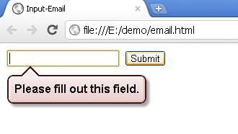
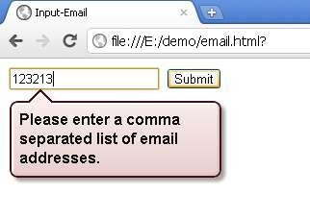
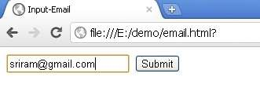
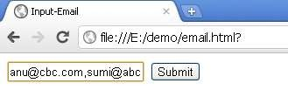
Input type – email (Contd.).
Field is empty
The value should be an email
Valid email – with a single email
Valid-More than 1 email

Slide 26
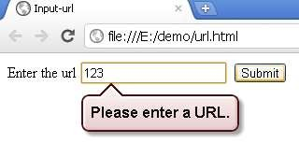
Input type - url
<input type="url" name="URL">
It is used for input fields that should contain a URL address
The value of the url field is automatically validated when the
form is submitted

Slide 27
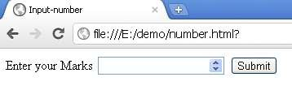
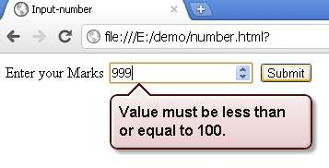
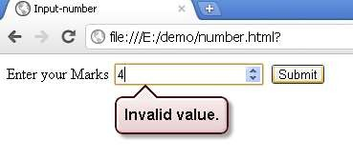
Input type - number
<input type="number" min="0" max="100">
Used to take a number as input
<input type="number" min="0 " max="100" step="3">
step -
specifies legal number intervals (if step="3", legal numbers could b
e -3,0,3,6, etc)

Slide 28
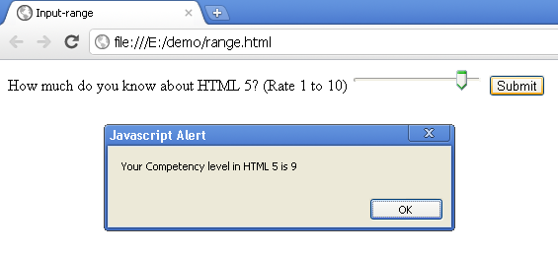
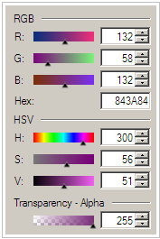
Input type - range
Slider control is a very useful user interface to set a number within a range
<input type="range" name="Range" min="1" max="10" required>

Slide 29
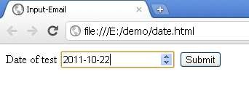
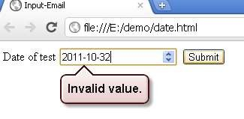
Input type – Date pickers - date
Date and time field can be easily found in many web forms
Typical applications are like ticket booking, appointment
booking etc
HTML5 the web browser ensures user can only enter a valid
date time string into the input textbox
<input type="date" name="set_date" />

Slide 30
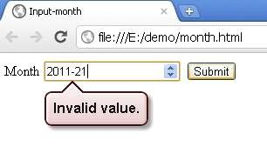
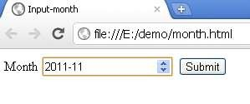
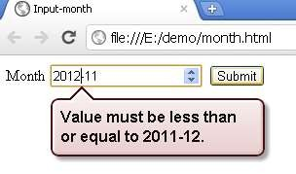
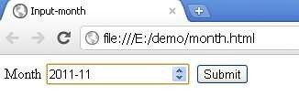
Input type – Date pickers – date (Contd.).
<input type="month" name="month" />
Creates a date input control for specifying a particular month
in a year
<input type="month" name="month" min="2011-1" max="2011-12"/>

Slide 31
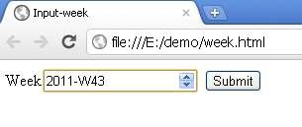
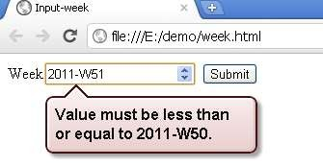
Input type – Date pickers – week
<input type="week" name="week" min="2011-W15" max="2011-W50"/>
Allows entry and validation of a week number

Slide 32
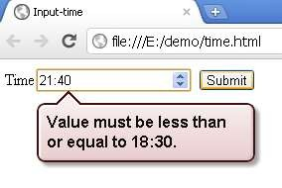
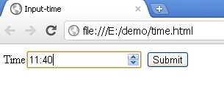
Input type – Date pickers – time
<input type="time" name="Time" min="11:40" max="18:30">
Allows entry and validation of a valid time

Slide 33
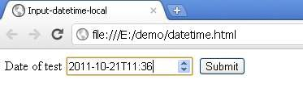
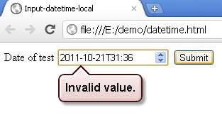
Input type – Date pickers – datetime-local
<input type="datetime-local" name="set_date" />
It creates a combined date/time input field
The value is an ISO formatted date and time

Slide 34

Input type - Search
<input type="search" name="Search">
It is used for search fields, like a site search, or Google search
The difference between search and text type is only stylistic
It takes the operating system’s default rounded-corners style for search
Currently Google Chrome does not support this

Slide 35
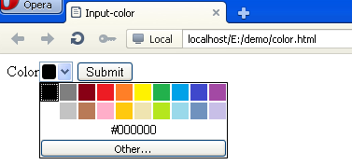
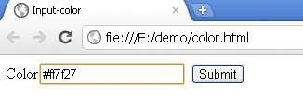
Input type - Color
Color <input type="color" name="Color" required>
Used to create a color control for selecting a color value
The Opera browser will allow you to select a color from a color picker
Color<input type="color" name="Color" required>
In Opera 11.52
In Google chrome 14.0

Slide 36
Input type - Color
<input type=“color” name=“get_color” value=“#000000”> value attribute of color
-------------------------
value = simple color
A string representing a color.
A string exactly seven characters long, consisting of the foll owing parts, in exactly the following order:
A "#" character.
Six characters in the range 0–9, a–f, and A–F.
Color keywords (for example, strings such as “red” or “gree n”) are not allowed

Slide 37
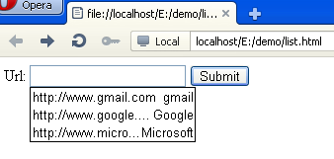
list attribute
The list attribute specifies a datalist for an input field
A datalist is a list of options for an input field
Url: <input type="text" list="url_list" name="url" />
<datalist id="url_list">
<option label="gmail" value="http://www.gmail.com" />
<option label="Google" value="http://www.google.com" />
<option label="Microsoft" value="http://www.microsoft.com" />
</datalist>

Slide 38
Example
<!DOCTYPE html>
<html>
<body>
<form action="color.jsp" method="get">
Url: <input type="text" list="url_list" name="url" />
<datalist id="url_list">
<option label="gmail" value="http://www.gmail.com" />
<option label="Google" value="http://www.google.com" />
<option label="Microsoft" value="http://www.microsoft.com" />
</datalist>
<input type="submit" />
</form>
</body>
</html>

Slide 39
Summary
In this module, you were able to :
Describe the new HTML5 input types
Apply date pickers on webpages
Use the new text box types on webpages
Use the new interactive text box types on webpages

Slide 40
Thank You

